Slide 1
The Logic of Hebbian Learning
Caleb Kisby, Saúl Blanco, Larry Moss
Contact: cckisby@iu.edu
INDIANA UNIVERSITY BLOOMINGTON

Slide 2
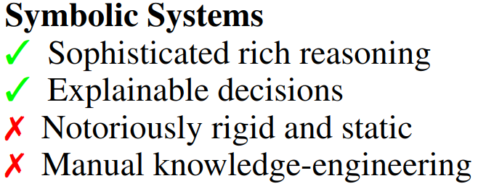
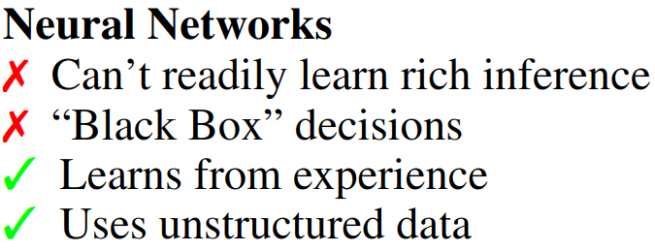
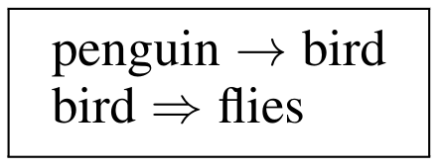
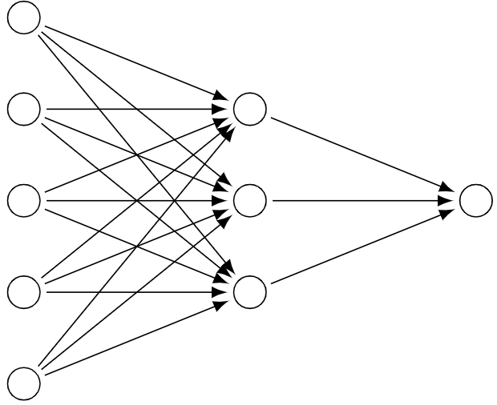
The Neuro-Symbolic Problem
Problem:
How do we bridge the two?

Slide 3
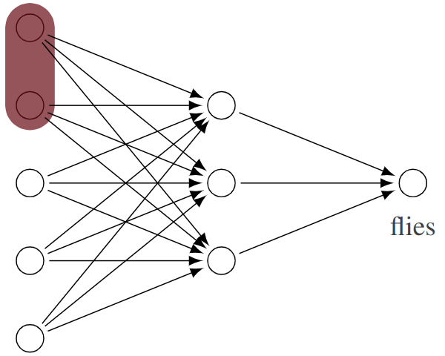
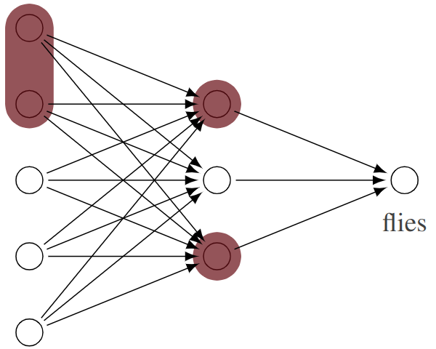
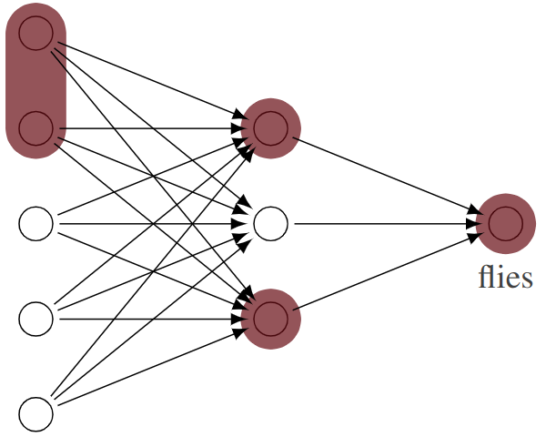
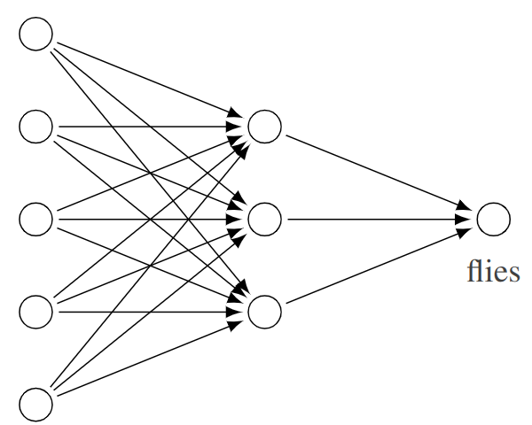
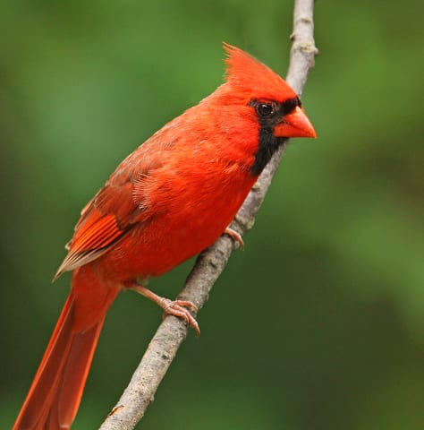
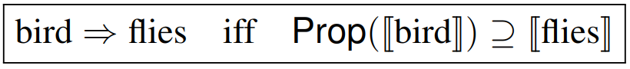
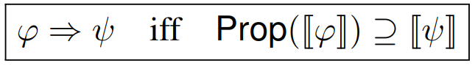
Forward Propagation & Conditionals
bird
Leitgeb, Hannes. "Nonmonotonic reasoning by inhibition nets."
Artificial Intelligence, 2001.

Slide 4
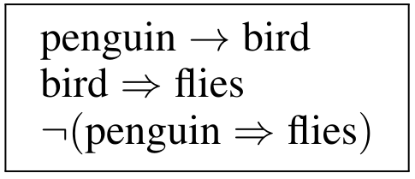
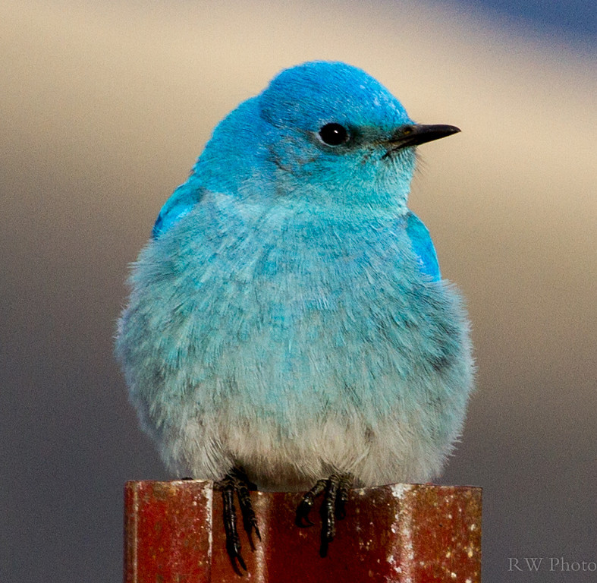
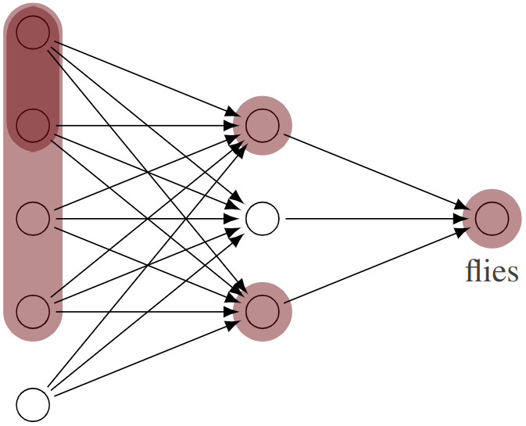
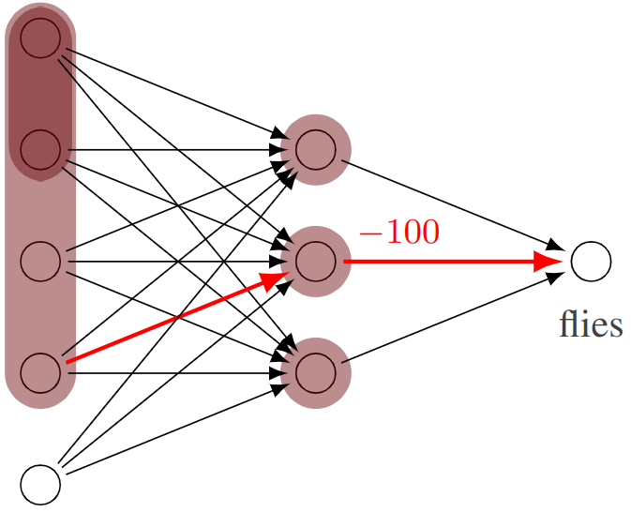
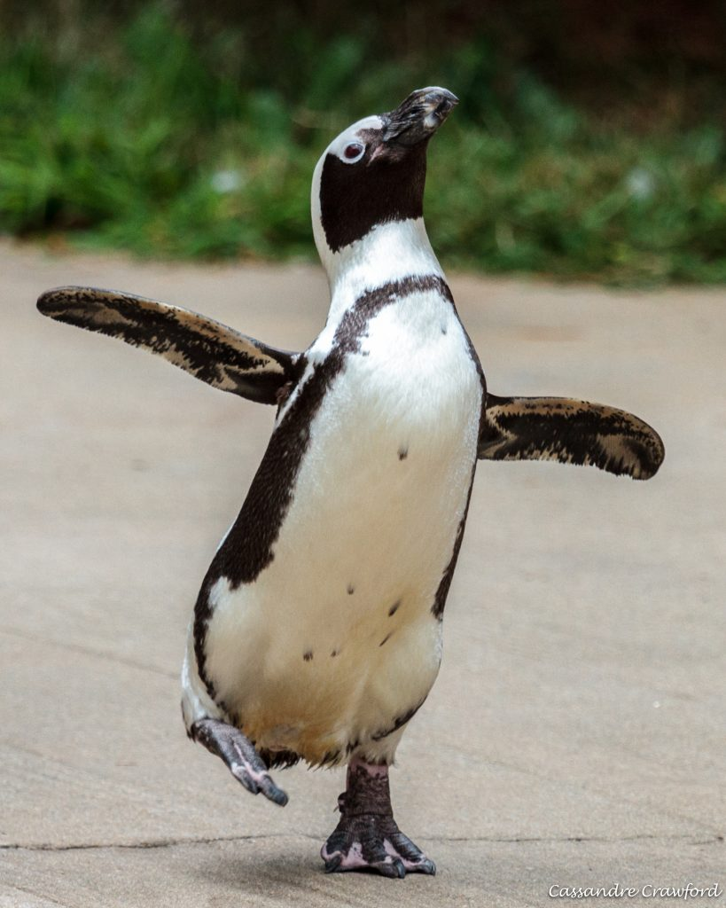
Learning Conditionals
Model Building
Extraction
Learning

Slide 5
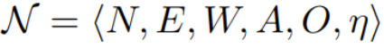
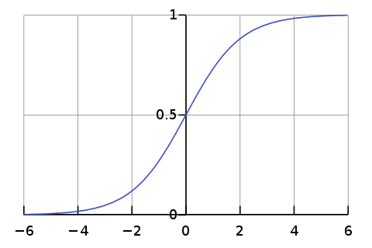
Simplifying Assumptions
Net is Feedforward
Activations are monotonically increasing
Neuron outputs are binary

Slide 6
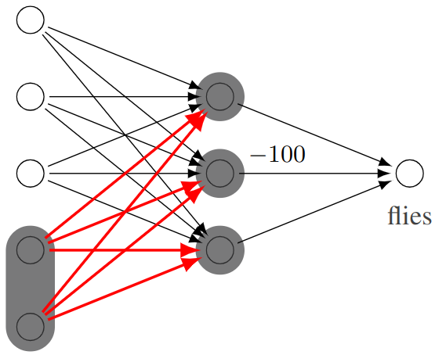
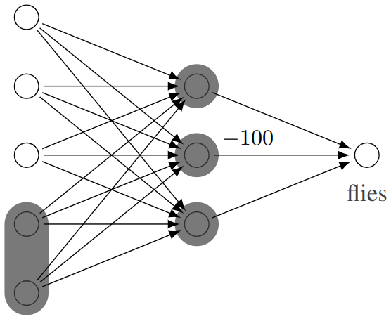
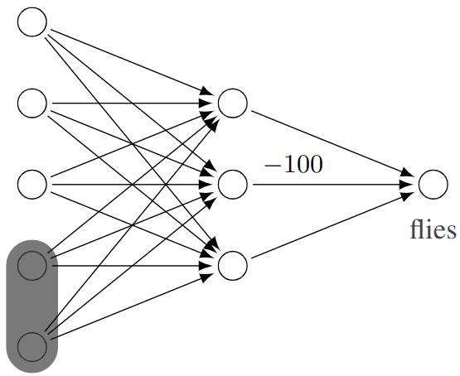
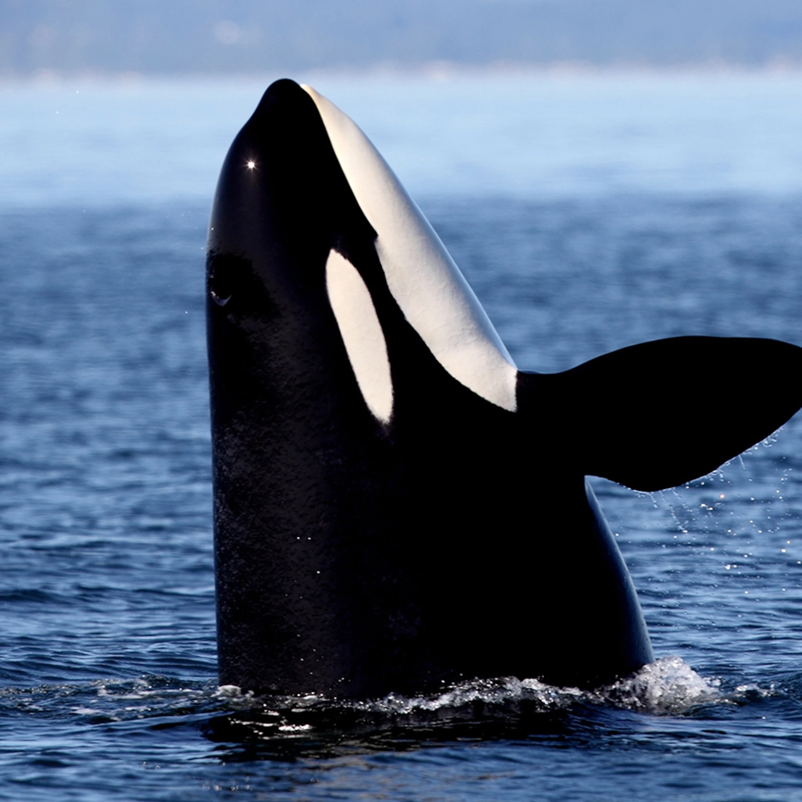
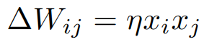
Hebbian Learning
Neurons that fire together wire together
orca

Slide 7
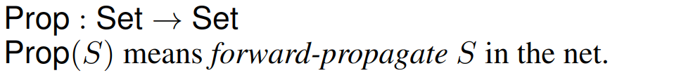
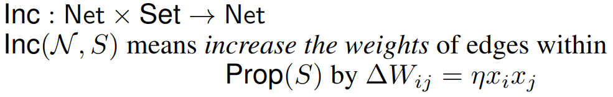
Prop and Inc

Slide 8
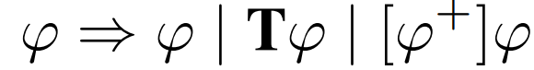
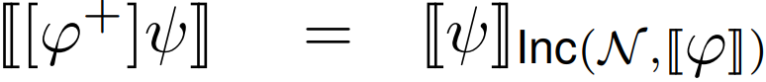
The Logic

Slide 9
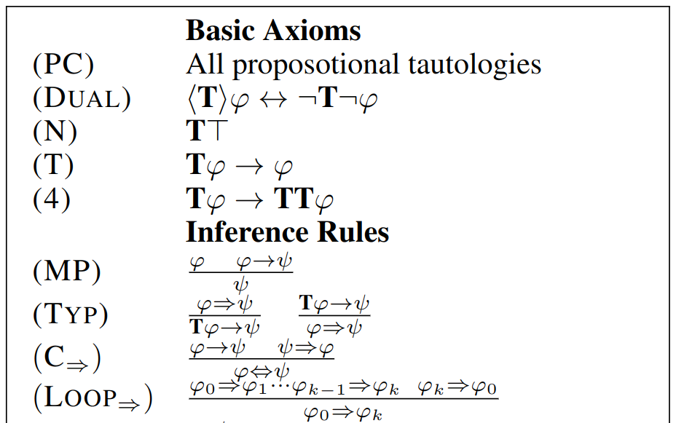
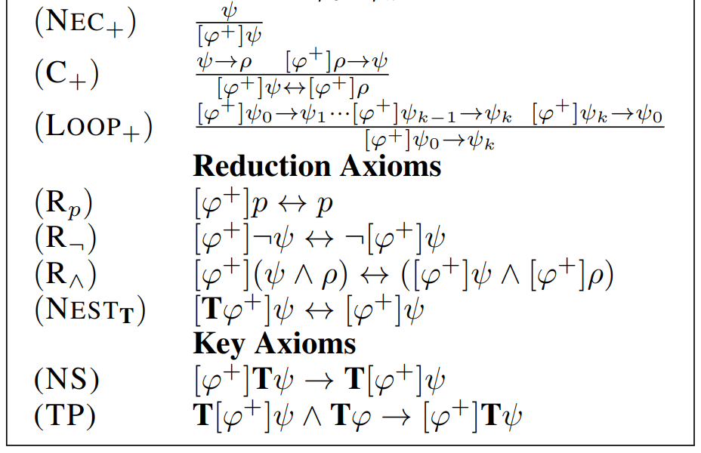
Some Axioms & Rules

Slide 10
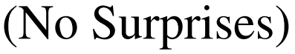
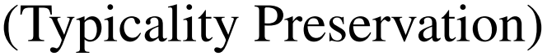
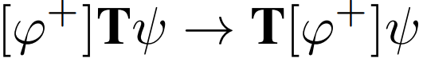
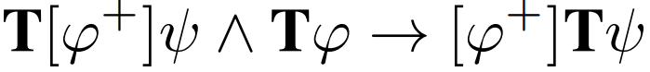
The Key Axioms

Slide 11
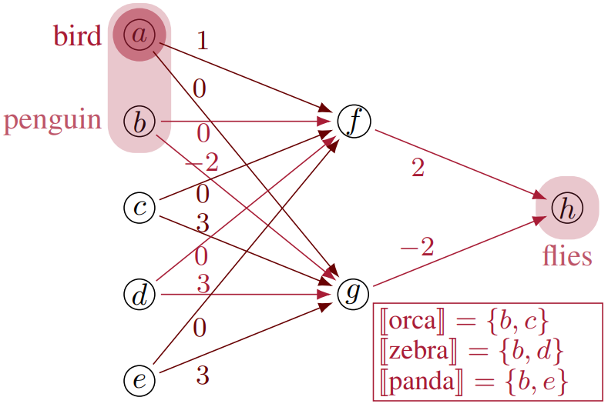
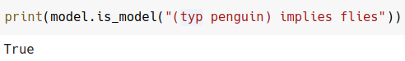
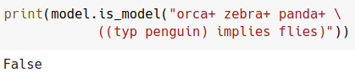
Working Code!

Slide 12
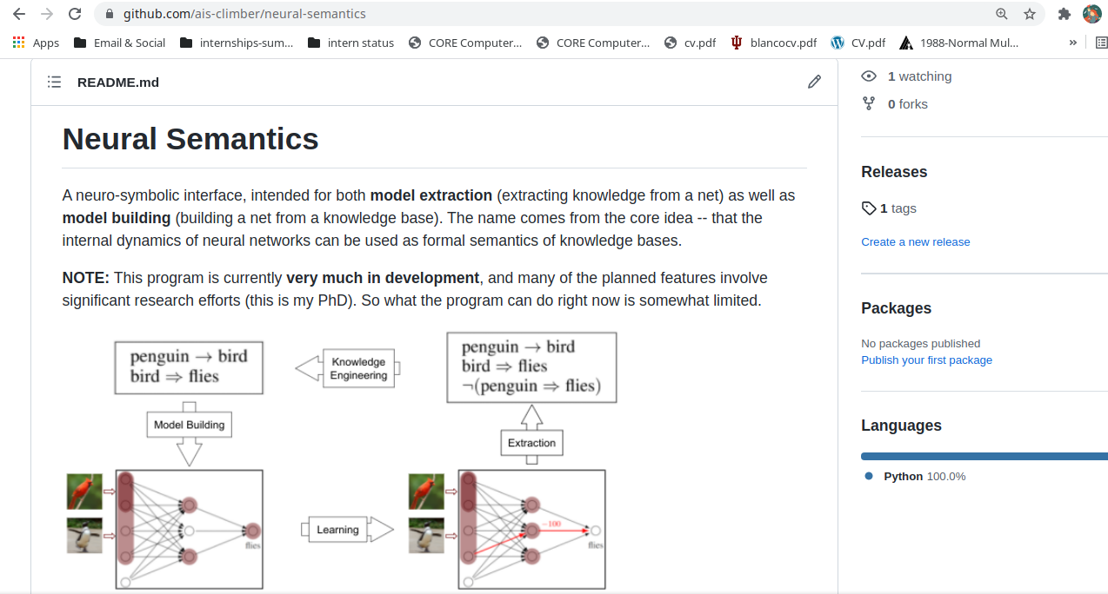
github.com/ais-climber/neural-semantics

Slide 13
Future Work: The Dream
Model Building (i.e. Completeness)
First-order logic
Nonbinary (fuzzy-valued) output
More varied activation functions (e.g. ReLU)
Learning via backpropagation

Slide 14
Questions?
Contact: cckisby@iu.edu
github.com/ais-climber/neural-semantics
Cardinal, penguin, and orca images belong to:
https://www.statecollege.com/wp-content/uploads/2021/01/1482147_44895.jpg
https://cincinnatizoo.org/system/assets/uploads/2020/08/charlie-240x300.jpg
https://i.natgeofe.com/k/0dc6e854-7054-4249-98c7-86de63e6333a/orca-spyhopping_square.jpg

Slide 15
Appendix / Helper Slides

Slide 16
The Logic: Rules of Inference

Slide 17
The Logic: Rules of Inference

Slide 18
Knowledge
Engineering
Model Building
Model Checking
Learning

